Slide 1

Concept Discussion: Unit testing and Mocking

Slide 2
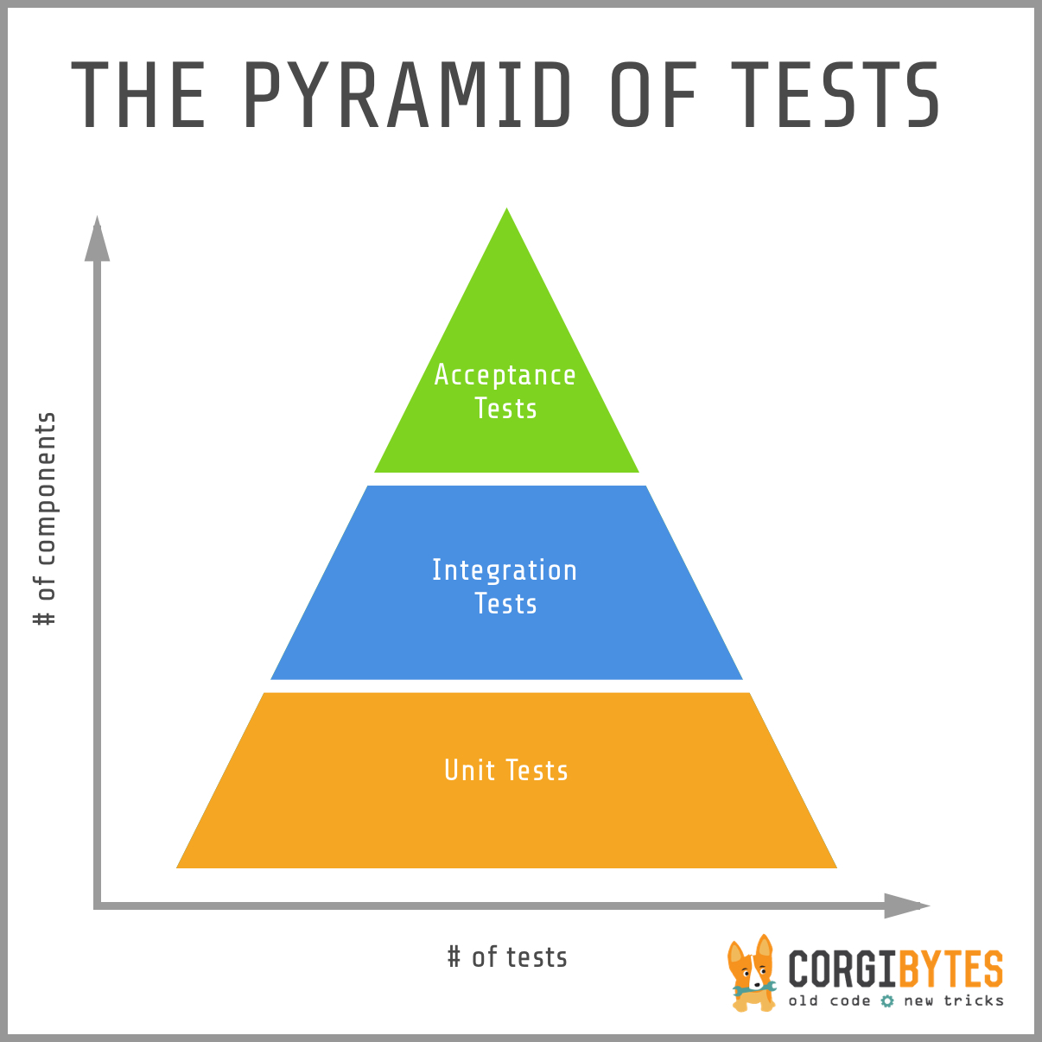
What are unit tests?
Code which tests a unit of functionality.
Unit tests assert that something is true or false.
Different types of testing: system tests, performance tests, unscripted testing
System Tests
Notes:
Code which tests one unit of functionality. Usually asserting that something is true or false.

Slide 3

Why do we have unit tests?
Catches bugs before they are merged to master
An excellent documentation tool
They encourage good programming practises
Helps find undiscovered bugs
Notes:
Excellent Documentation tool: They show you the inputs and outputs for a given function. They can also show you the failure cases (what erroneous data will look like) for the functions.
Good programming practises: easier to test small functions where each piece of functionality has been isolated.
Helps find undiscovered bugs: Writing unit tests will help you think of edgecases to the code you are testing, and so it can sometimes help you find potential problems with your code.

Slide 4
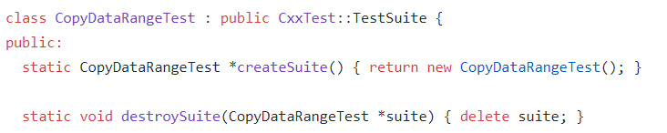
How to write unit tests?
Import the testing module
Create your test class

Slide 5


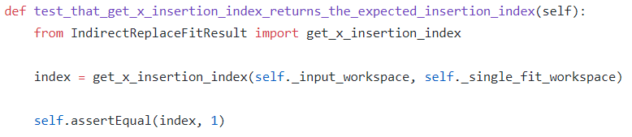
How to write unit tests?
Setup and teardown (optional) – setup is called before every test, and teardown is called after every test.
Write your tests – your tests need to be public and start with ‘test’ in the name

Slide 6
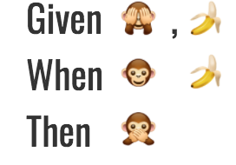
How to write good unit tests?
A good name for the test
A good structure (Given/When/Then)
Tests ONE unit of functionality
Short and readable
Notes:
Good name: A good name will almost read exactly like a sentence, and is very useful if your test fails on the server. It is also essential for documentation purposes.
Short and readable: For documentation reasons it is easier to understand short tests. Easier to fix failing unit tests if they are short.

Slide 7
Assertion types
Python | C++ | Description
self.assertTrue(expr) | TS_ASSERT(expr) | Verify (expr) is true
self.assertEqual(x, y) | TS_ASSERT_EQUALS(x, y) | Verify (x==y)
self.assertDelta(x, y, d) | TS_ASSERT_DELTA(x, y, d) | Verify (x==y) with tolerance d
self.assertNotEqual(x, y) | TS_ASSERT_DIFFERS(x, y) | Verify (x!=y)
with self.assertRaises(type): expr | TS_ASSERT_THROWS(expr, type) | Verify (expr) throws an exception
assertRaisesNothing(self, expr) | TS_ASSERT_THROWS_NOTHING(expr) | Verify (expr) throws nothing

Slide 8
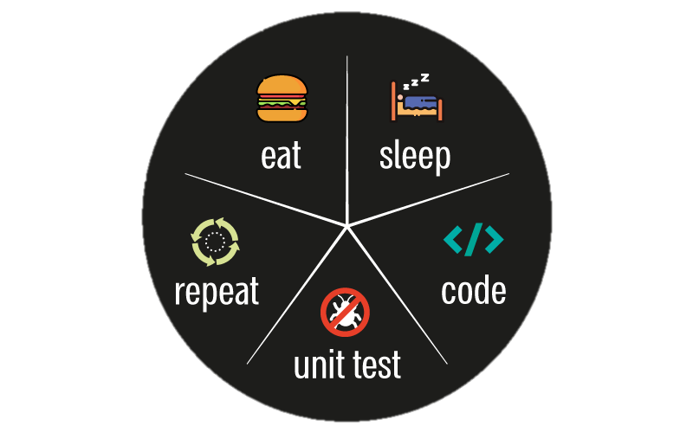
Examples
Notes:
LIVE review

Slide 9
Additional notes on unit tests
Don’t worry about how long it takes to run your unit tests. The important thing is that we have good quality tests, which provide a large amount of coverage!
It is better to generate any input data for your test within the setup, than to load in pre-prepared data.
‘ReduceData’ Algorithm
Load in previously saved data
Setup option 1
Tests
Setup option 2
‘Fit’ Algorithm
Saved data is constant
The data from this algorithm can change if a future change is made to the algorithm
Notes:
Generate input data because loaded data can be outdated and so irrelevant to what you are testing.

Slide 10
What is mocking?
Used to ‘Mock’ an object which might be a complex structure (e.g. a qt widget), the details of which are not important for the test.
An example would be to mock a View (in an MVP pattern), or to mock a widget.
Complex dependency
Test
The unit being tested
Mock Object
Notes:
You can mock anything! The reasons why you might want to mock something:
It is a complex dependency (qt stuff)
It is unimportant to what we are testing, and so we want to ignore it

Slide 11
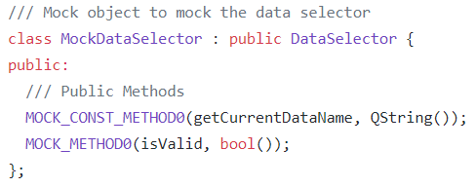
How to use mocking (c++)?
#include <gmock/gmock.h>
Define your mock objects
Number of parameters
Function name
Return type
Parameters go in here

Slide 12
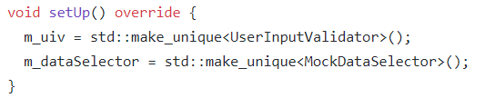
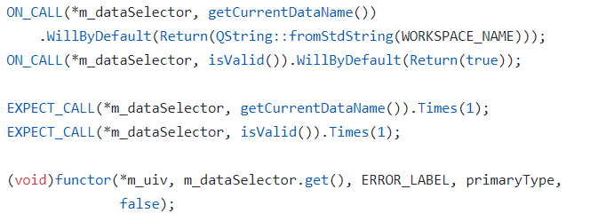
How to use mocking (c++)?
Create your mock objects
Write your tests (Setup/Expectations/Invoke expectations)
https://github.com/google/googletest/blob/master/googlemock/docs/cheat_sheet.md
Notes:
Different structure for c++ mocking:
Setup (create data and specify the ON_CALL’s)
Expectations (Specify the EXPECT_CALL’s)
Invoke Expectations (Call the function you are testing)

Slide 13

Mocking Examples

Slide 14
Summary
What is a unit test?
Why do we have unit tests?
What makes a GOOD unit test?
What is mocking and why do we use it?
Anything else?

